Slide 1
Chapter 6: CPU Scheduling

Slide 2
Chapter 6: CPU Scheduling
Basic Concepts
Scheduling Criteria
Scheduling Algorithms
Thread Scheduling
Multiple-Processor Scheduling
Real-Time CPU Scheduling
Operating Systems Examples
Algorithm Evaluation

Slide 3
Objectives
To introduce CPU scheduling, which is the basis for multiprogrammed operating systems
To describe various CPU-scheduling algorithms
To discuss evaluation criteria for selecting a CPU-scheduling algorithm for a particular system
To examine the scheduling algorithms of several operating systems

Slide 4
Basic Concepts
Maximum CPU utilization obtained with multiprogramming
CPU–I/O Burst Cycle – Process execution consists of a cycle of CPU execution and I/O wait
CPU burst followed by I/O burst
CPU burst distribution is of main concern

Slide 5
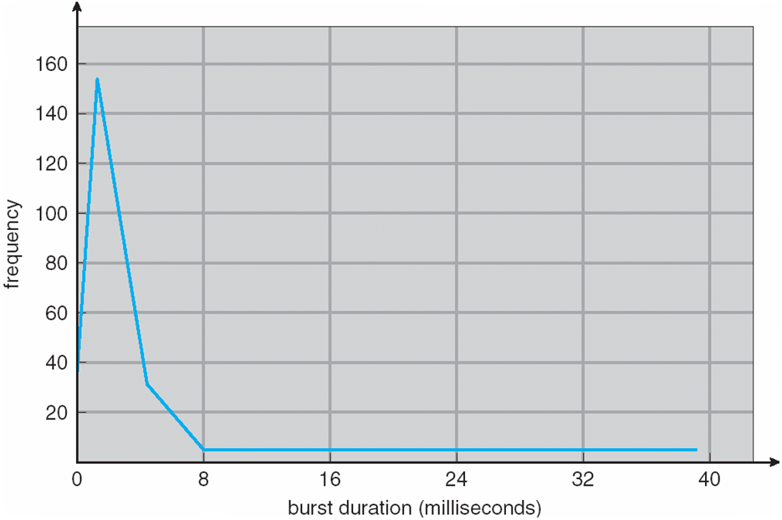
Histogram of CPU-burst Times

Slide 6
CPU Scheduler
Short-term scheduler selects from among the processes in ready queue, and allocates the CPU to one of them
  Queue may be ordered in various ways
CPU scheduling decisions may take place when a process:
  1. Switches from running to waiting state
  2. Switches from running to ready state
  3. Switches from waiting to ready
  Terminates
Scheduling under 1 and 4 is nonpreemptive
All other scheduling is preemptive
  Consider access to shared data
  Consider preemption while in kernel mode
  Consider interrupts occurring during crucial OS activities

Slide 7
Dispatcher
Dispatcher module gives control of the CPU to the process selected by the short-term scheduler; this involves:
  switching context
  switching to user mode
  jumping to the proper location in the user program to restart that program
Dispatch latency – time it takes for the dispatcher to stop one process and start another running

Slide 8
Scheduling Criteria
CPU utilization – keep the CPU as busy as possible
Throughput – # of processes that complete their execution per time unit
Turnaround time – amount of time to execute a particular process
Waiting time – amount of time a process has been waiting in the ready queue
Response time – amount of time it takes from when a request was submitted until the first response is produced, not output (for time-sharing environment)

Slide 9
Scheduling Algorithm Optimization Criteria
Max CPU utilization
Max throughput
Min turnaround time
Min waiting time
Min response time

Slide 10
Various Times Related To Process-

Slide 11
Various Times Related To Process-
1. Arrival Time-
Arrival time is the point of time at which a process enters the ready queue.
2. Waiting Time-
Waiting time is the amount of time spent by a process waiting in the ready queue for getting the CPU.
3. Response Time-
Response time is the amount of time after which a process gets the CPU for the first time after entering the ready queue.
Waiting time = Turn Around time – Burst time
Response Time = Time at which process first gets the CPU – Arrival time

Slide 12
Various Times Related To Process-
4. Burst Time-
Burst time is the amount of time required by a process for executing on CPU.
It is also called as execution time or running time.
Burst time of a process can not be known in advance before executing the process.
It can be known only after the process has executed.
5. Completion Time-
Completion time is the point of time at which a process completes its execution on the CPU and takes exit from the system.
It is also called as exit time.

Slide 13
Various Times Related To Process-
6. Turn Around Time-
Turn Around time is the total amount of time spent by a process in the system.
When present in the system, a process is either waiting in the ready queue for getting the CPU or it is executing on the CPU.
OR
Turn Around time = Burst time + Waiting time
Turn Around time = Completion time – Arrival time

Slide 14
First- Come, First-Served (FCFS) Scheduling
Process Burst Time
P₁ 24
P₂ 3
P₃ 3
Suppose that the processes arrive in the order: P₁ , P₂ , P₃
The Gantt Chart for the schedule is:
Waiting time for P₁ = 0; P₂ = 24; P₃ = 27
Average waiting time: (0 + 24 + 27)/3 = 17

Slide 15
First- Come, First-Served (FCFS) Scheduling
Average turn around time:
The turn around time for process P1 = 24-0 = 24 msecs
The turn around time for process P2 = 27-0 = 27 msecs
The turn around time for process P3 = 30-0 = 30 msecs
Average turn around time = (24 + 27 + 30) / 3 = 81 / 3 =27 msecs
Average response time:
The response time for process P1 = 0-0 = 0 msecs
The response time for process P2 = 24-0 = 24 msecs
The response time for process P3 = 27-0 = 27 msecs
Average response time = (0 + 24 + 27) / 3 = 51 / 3 = 17 msecs

Slide 16
FCFS Scheduling (Cont.)
Suppose that the processes arrive in the order:
P₂ , P₃ , P₁
The Gantt chart for the schedule is:
Waiting time for P₁ = 6; P₂ = 0; P₃ = 3
Average waiting time: (6 + 0 + 3)/3 = 3
Much better than previous case
Convoy effect - short process behind long process
  Consider one CPU-bound and many I/O-bound processes

Slide 17
FCFS Scheduling (Cont.)
Turn around time for P2 = 3-0 = 3; P3 = 6-0 = 6; P1 = 30-0 =30
Average turnaround time = (3 + 6 + 30) / 3 = 39 / 3 = 13
Response time for P2 = 0; P3 = 3-0 = 3; P1 = 6-0 = 6
Average response time = (0 + 3 + 6) / 3 = 9 / 3 =3 msecs

Slide 18
Shortest-Job-First (SJF) Scheduling
Associate with each process the length of its next CPU burst
  Use these lengths to schedule the process with the shortest time
SJF is optimal – gives minimum average waiting time for a given set of processes
  The difficulty is knowing the length of the next CPU request
  Could ask the user

Slide 19
Example of SJF
ProcessArriva l Time Burst Time
P₁ 0.0 6
P₂ 2.0 8
P₃ 4.0 7
P₄ 5.0 3
SJF scheduling chart
Average waiting time = (3 + 16 + 9 + 0) / 4 = 7

Slide 20
Determining Length of Next CPU Burst
Can only estimate the length – should be similar to the previous one
  Then pick process with shortest predicted next CPU burst
Can be done by using the length of previous CPU bursts, using exponential averaging
Commonly, α set to ½
Preemptive version called shortest-remaining-time-first

Slide 21
Prediction of the Length of the Next CPU Burst

Slide 22
Examples of Exponential Averaging
α =0
  τ_{n+1} = τ_{n}
  Recent history does not count
α =1
  τ_{n+1} = α t_{n}
  Only the actual last CPU burst counts
If we expand the formula, we get:
    τ_{n+1} = α t_{n}+(1 - α)α t_{n} ₋₁ + …
    +(1 - α )^{j} α t_{n} _{-j} + …
    +(1 - α )^{n +1} τ₀
Since both α and (1 - α) are less than or equal to 1, each successive term has less weight than its predecessor

Slide 23
Example of Shortest-remaining-time-first
Now we add the concepts of varying arrival times and preemption to the analysis
ProcessA arri Arrival TimeT Burst Time
P₁ 0 8
P₂ 1 4
P₃ 2 9
P₄ 3 5
Preemptive SJF Gantt Chart
Average waiting time = [(10-1)+(1-1)+(17-2)+5-3)]/4 = 26/4 = 6.5 msec

Slide 24
Priority Scheduling
A priority number (integer) is associated with each process
The CPU is allocated to the process with the highest priority (smallest integer ≡ highest priority)
  Preemptive
  Nonpreemptive
SJF is priority scheduling where priority is the inverse of predicted next CPU burst time
Problem ≡ Starvation – low priority processes may never execute
Solution ≡ Aging – as time progresses increase the priority of the process

Slide 25
Example of Priority Scheduling
ProcessA arri Burst TimeT Priority
P₁ 10 3
P₂ 1 1
P₃ 2 4
P₄ 1 5
P₅ 5 2
Priority scheduling Gantt Chart
Average waiting time = 8.2 msec
2
5

Slide 26
Round Robin (RR)
Each process gets a small unit of CPU time (time quantum q), usually 10-100 milliseconds. After this time has elapsed, the process is preempted and added to the end of the ready queue.
If there are n processes in the ready queue and the time quantum is q, then each process gets 1/n of the CPU time in chunks of at most q time units at once. No process waits more than (n-1)q time units.
Timer interrupts every quantum to schedule next process
Performance
  q large ⇒ FIFO
  q small ⇒ q must be large with respect to context switch, otherwise overhead is too high

Slide 27
Example of RR with Time Quantum = 4
Process Burst Time
P₁ 24
P₂ 3
P₃ 3
The Gantt chart is:
Typically, higher average turnaround than SJF, but better response
q should be large compared to context switch time
q usually 10ms to 100ms, context switch < 10 usec

Slide 28
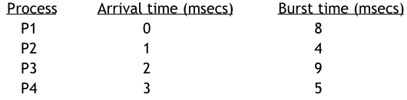
Example:
Example: Given below are the arrival and burst times of four processes P1, P2, P3 and P4. Draw the Gantt Chart using FCFS, SJF preemptive, SJF non-preemptive and RR scheduling(Quantum = 4ms, no priority based preemption). Calculate the average waiting time, average turn around time and average response

Slide 29
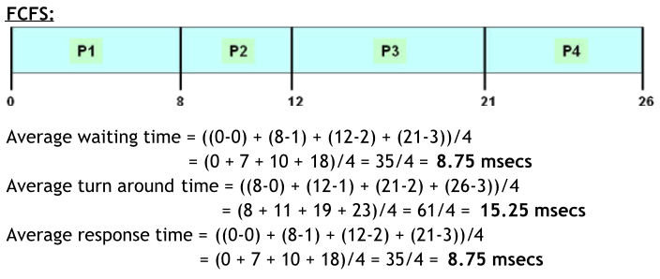
Example (Cont.)

Slide 30
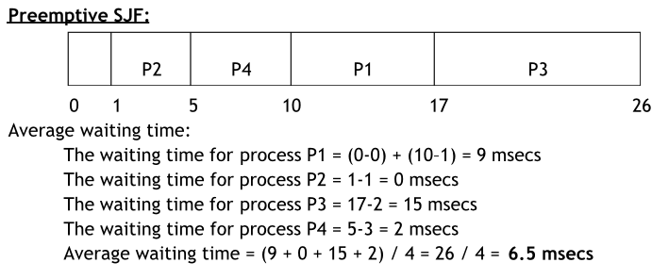
Example (Cont.)

Slide 31
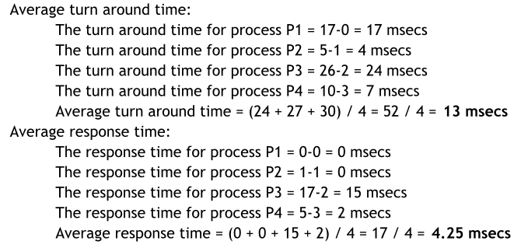
Example (Cont.)

Slide 32
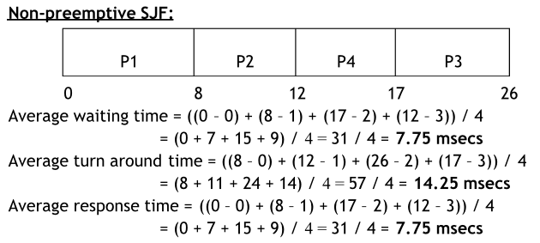
Example (Cont.)

Slide 33
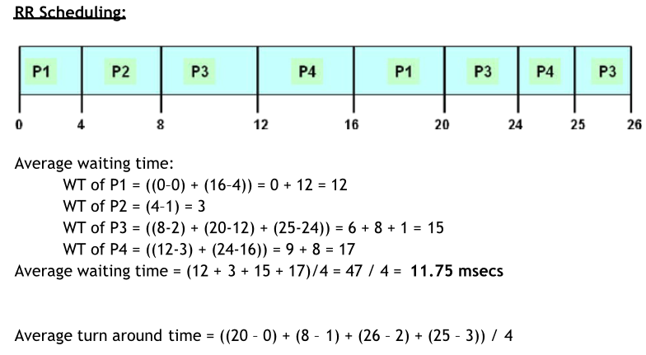
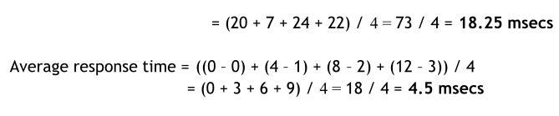
Example (Cont.)

Slide 34
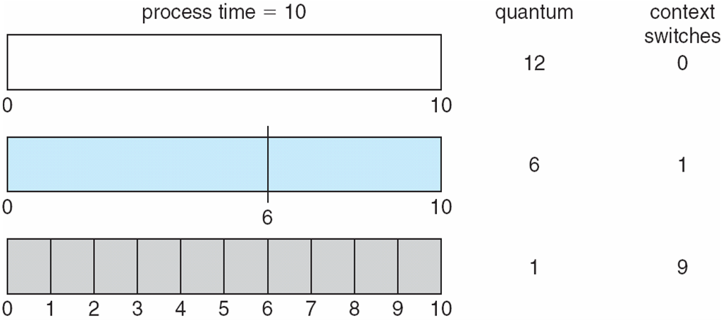
Time Quantum and Context Switch Time

Slide 35
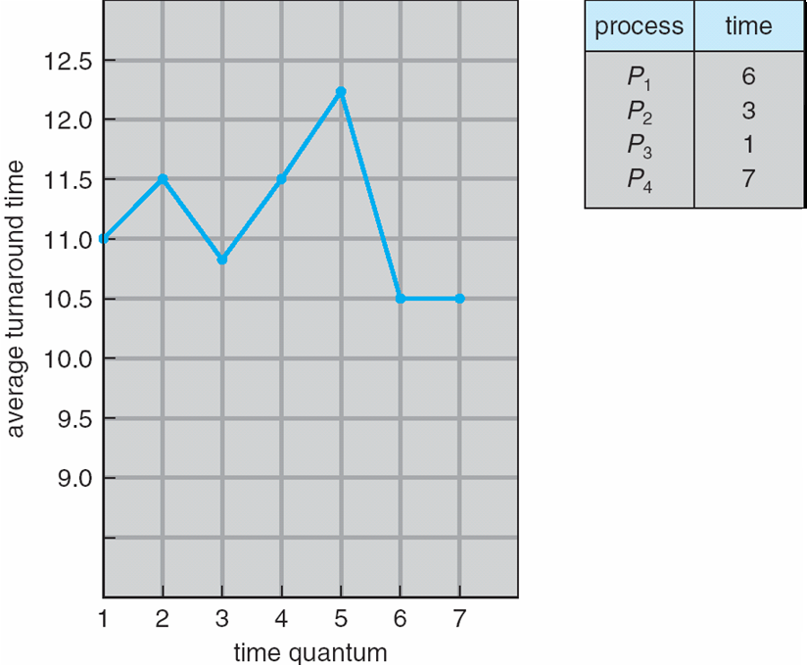
Turnaround Time Varies With The Time Quantum
80% of CPU bursts should be shorter than q

Slide 36
Multilevel Queue
Ready queue is partitioned into separate queues, eg:
  foreground (interactive)
  background (batch)
Process permanently in a given queue
Each queue has its own scheduling algorithm:
  foreground – RR
  background – FCFS
Scheduling must be done between the queues:
  Fixed priority scheduling; (i.e., serve all from foreground then from background). Possibility of starvation.
  Time slice – each queue gets a certain amount of CPU time which it can schedule amongst its processes; i.e., 80% to foreground in RR
  20% to background in FCFS

Slide 37
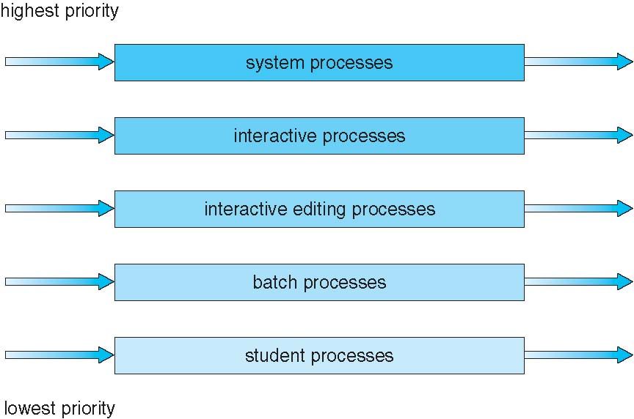
Multilevel Queue Scheduling

Slide 38
Multilevel Feedback Queue
A process can move between the various queues; aging can be implemented this way
Multilevel-feedback-queue scheduler defined by the following parameters:
  number of queues
  scheduling algorithms for each queue
  method used to determine when to upgrade a process
  method used to determine when to demote a process
  method used to determine which queue a process will enter when that process needs service

Slide 39
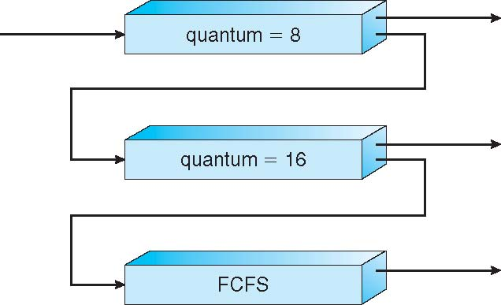
Example of Multilevel Feedback Queue
Three queues:
  Q₀ – RR with time quantum 8 milliseconds
  Q₁ – RR time quantum 16 milliseconds
  Q₂ – FCFS
Scheduling
  A new job enters queue Q₀ which is served FCFS (RR)
    When it gains CPU, job receives 8 milliseconds
    If it does not finish in 8 milliseconds, job is moved to queue Q₁
  At Q₁ job is again served FCFS (RR) and receives 16 additional milliseconds
    If it still does not complete, it is preempted and moved to queue Q₂

Slide 40
Thread Scheduling
Distinction between user-level and kernel-level threads
When threads supported, threads scheduled, not processes
Many-to-one and many-to-many models, thread library schedules user-level threads to run on LWP
  Known as process-contention scope (PCS) since scheduling competition is within the process
  Typically done via priority set by programmer
Kernel thread scheduled onto available CPU is system-contention scope (SCS) – competition among all threads in system

Slide 41
Multiple-Processor Scheduling
CPU scheduling more complex when multiple CPUs are available
Homogeneous processors within a multiprocessor
Asymmetric multiprocessing – only one processor accesses the system data structures, alleviating the need for data sharing
Symmetric multiprocessing (SMP) – each processor is self-scheduling, all processes in common ready queue, or each has its own private queue of ready processes
  Currently, most common
Processor affinity – process has affinity for processor on which it is currently running
  soft affinity
  hard affinity
  Variations including processor sets

Slide 42
NUMA and CPU Scheduling
Note that memory-placement algorithms can also consider affinity

Slide 43
Multiple-Processor Scheduling – Load Balancing
If SMP, need to keep all CPUs loaded for efficiency
Load balancing attempts to keep workload evenly distributed
Push migration – periodic task checks load on each processor, and if found pushes task from overloaded CPU to other CPUs
Pull migration – idle processors pulls waiting task from busy processor

Slide 44
Multicore Processors
Recent trend to place multiple processor cores on same physical chip
Faster and consumes less power
Multiple threads per core also growing
  Takes advantage of memory stall to make progress on another thread while memory retrieve happens

Slide 45
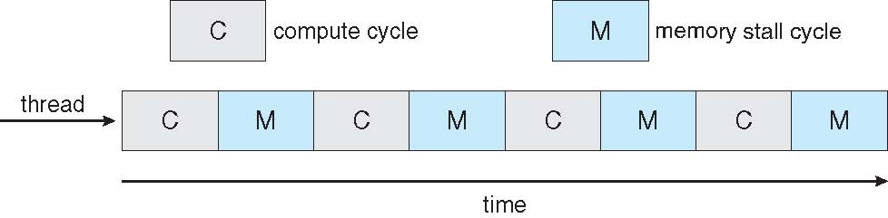

Multithreaded Multicore System

Slide 46
Virtualization and Scheduling
Virtualization software schedules multiple guests onto CPU(s)
Each guest doing its own scheduling
  Not knowing it doesn’t own the CPUs
  Can result in poor response time
  Can effect time-of-day clocks in guests
Can undo good scheduling algorithm efforts of guests

Slide 47
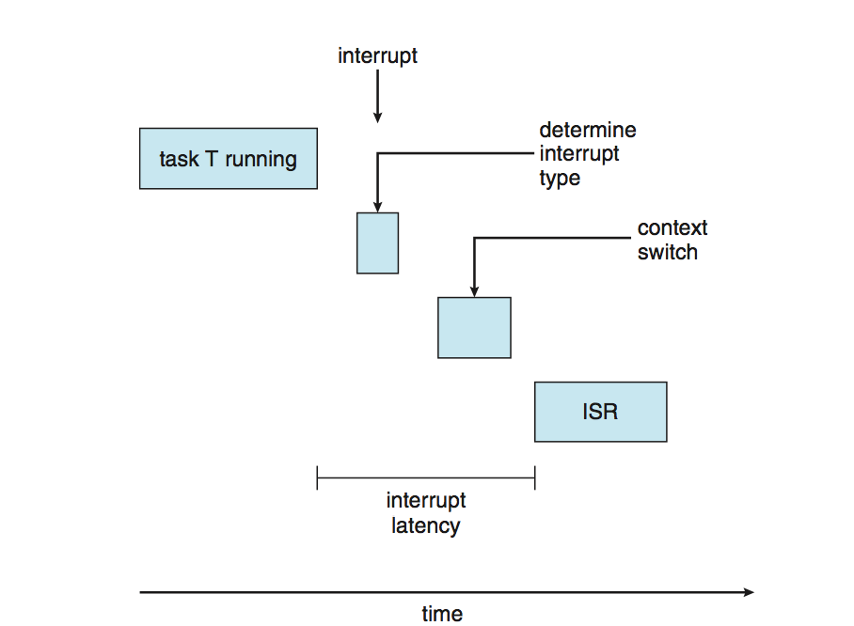
Real-Time CPU Scheduling
Can present obvious challenges
Soft real-time systems – no guarantee as to when critical real-time process will be scheduled
Hard real-time systems – task must be serviced by its deadline
Two types of latencies affect performance
  Interrupt latency – time from arrival of interrupt to start of routine that services interrupt
  Dispatch latency – time for schedule to take current process off CPU and switch to another

Slide 48
Real-Time CPU Scheduling (Cont.)
Conflict phase of dispatch latency:
  Preemption of any process running in kernel mode
  Release by low-priority process of resources needed by high-priority processes

Slide 49
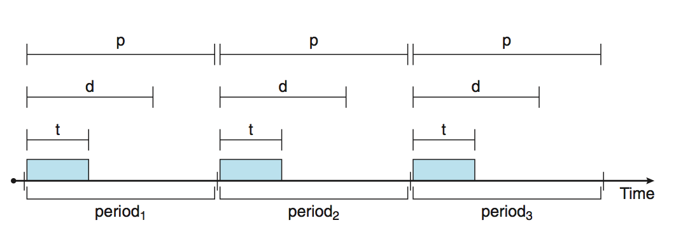
Priority-based Scheduling
For real-time scheduling, scheduler must support preemptive, priority-based scheduling
  But only guarantees soft real-time
For hard real-time must also provide ability to meet deadlines
Processes have new characteristics: periodic ones require CPU at constant intervals
  Has processing time t, deadline d, period p
  0 ≤ t ≤ d ≤ p
  Rate of periodic task is 1/p

Slide 50
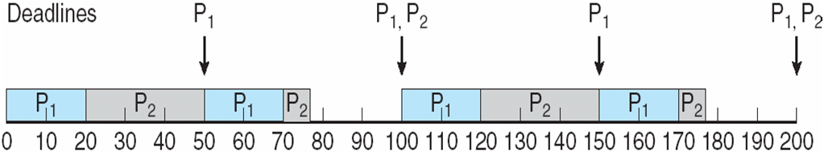
Rate Montonic Scheduling
A priority is assigned based on the inverse of its period
Shorter periods = higher priority;
Longer periods = lower priority
P₁ is assigned a higher priority than P₂.

Slide 51
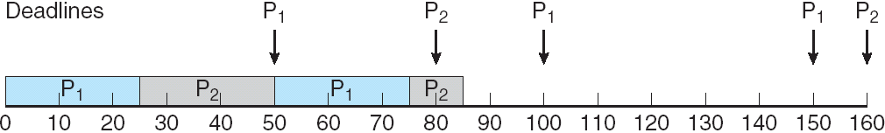
Missed Deadlines with Rate Monotonic Scheduling

Slide 52
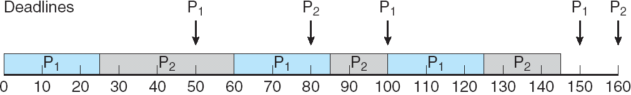
Earliest Deadline First Scheduling (EDF)
Priorities are assigned according to deadlines:
the earlier the deadline, the higher the priority;
the later the deadline, the lower the priority

Slide 53
Proportional Share Scheduling
T shares are allocated among all processes in the system
An application receives N shares where N < T
This ensures each application will receive N / T of the total processor time

Slide 54
End of Chapter 6

